Slide 1
Fundamentals of High Voltage Techniques

Slide 2
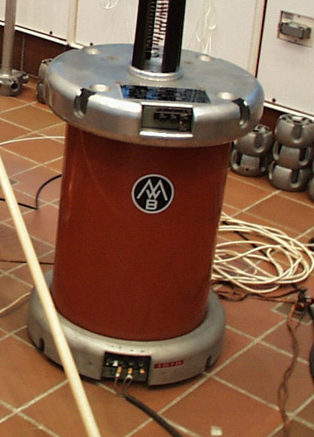
Fundamentals of High Voltage Techniques

Slide 3
Fundamentals of High Voltage Techniques

Slide 4
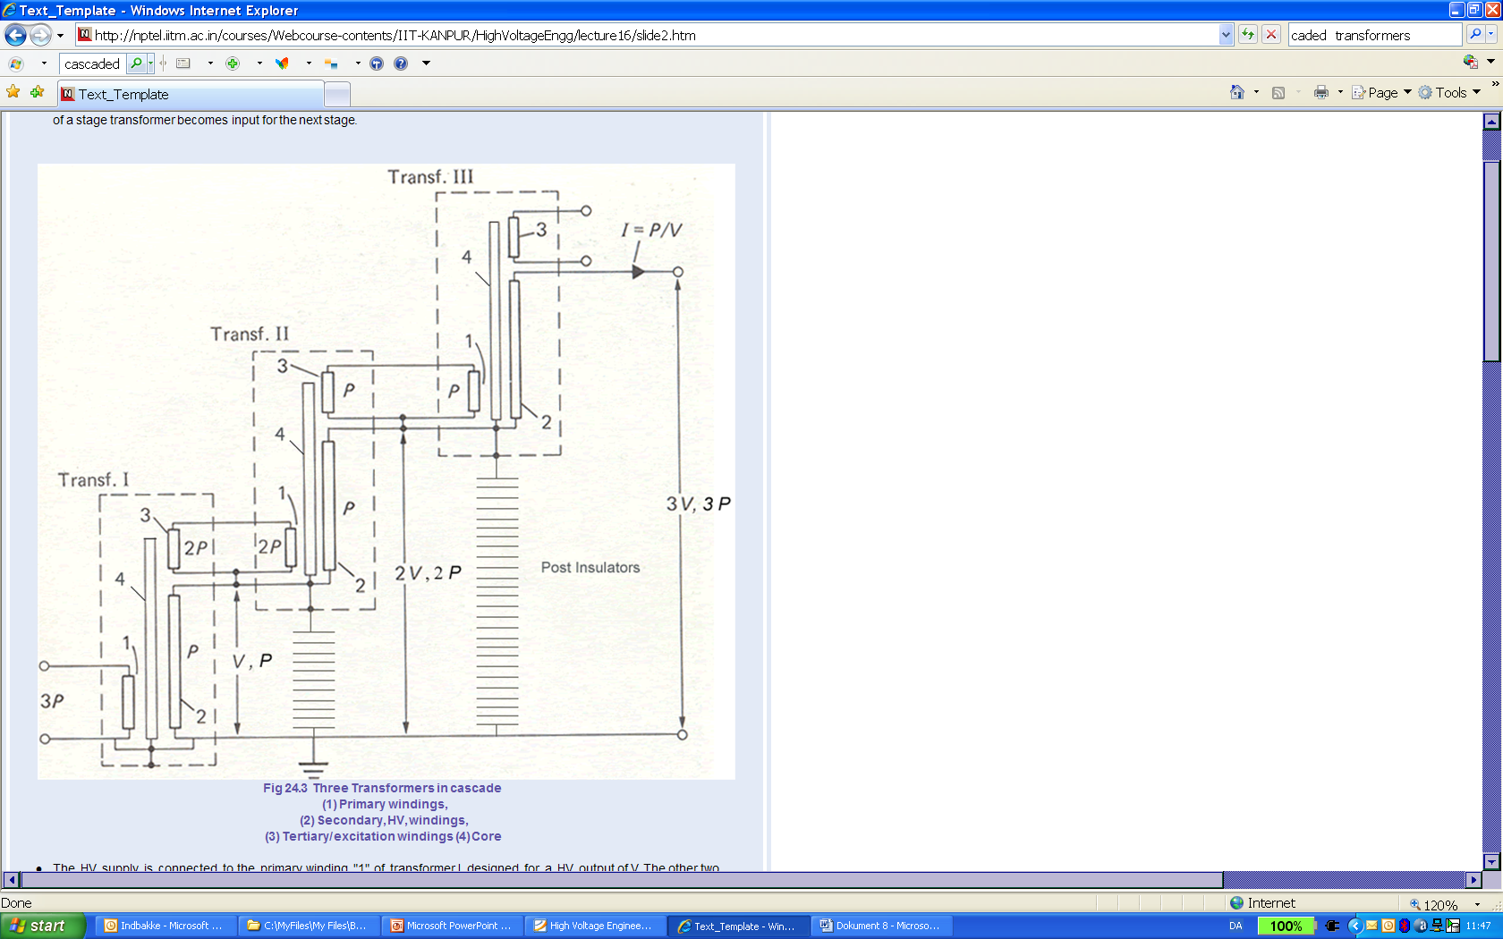
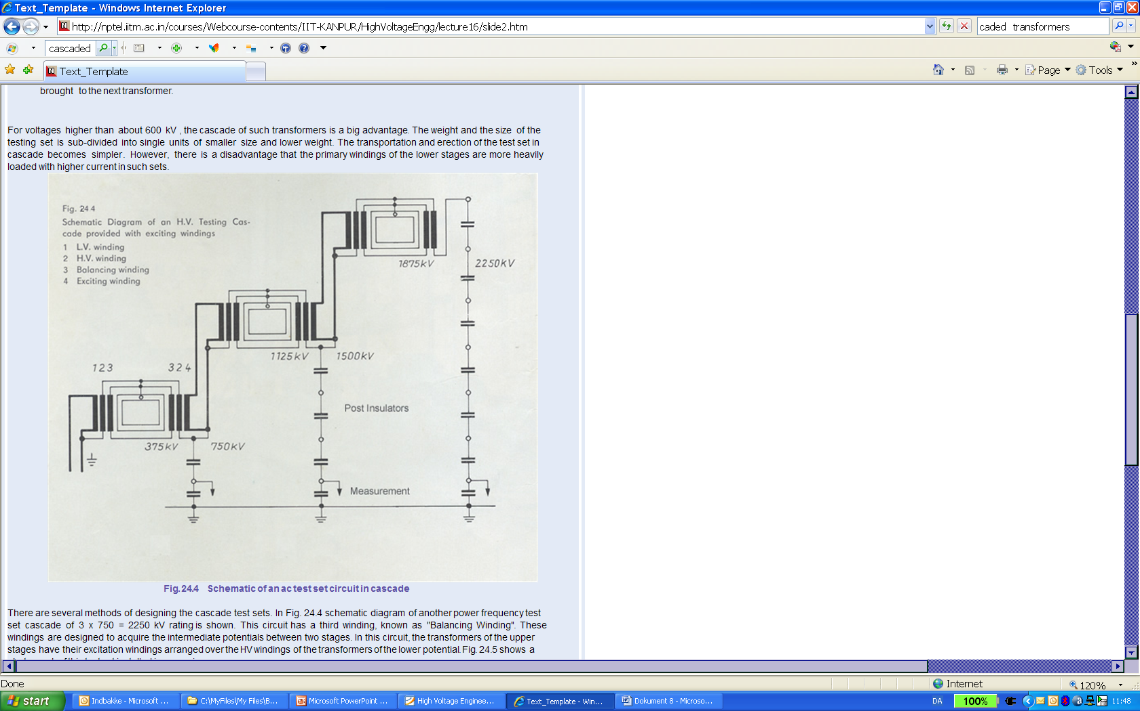
Fundamentals of High Voltage Techniques

Slide 5
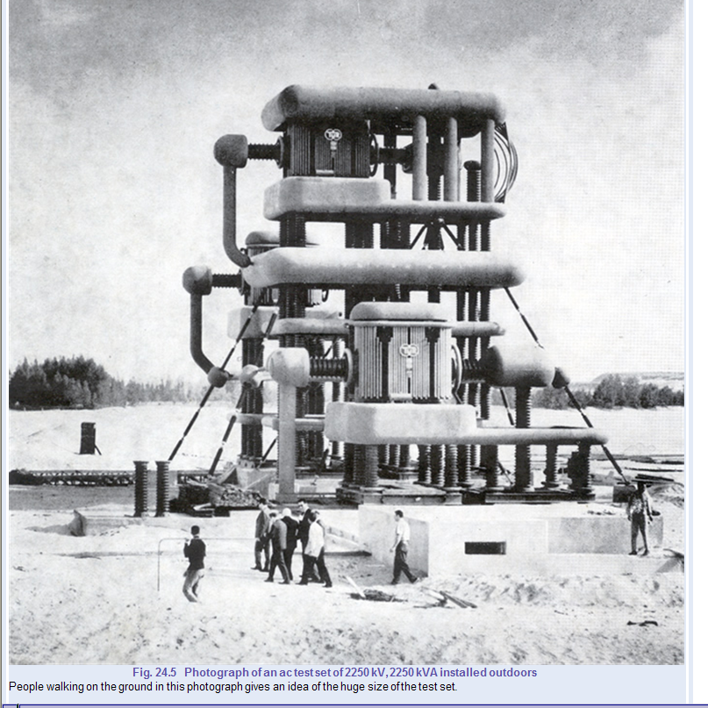
Fundamentals of High Voltage Techniques

Slide 6
Fundamentals of High Voltage Techniques

Slide 7
Fundamentals of High Voltage Techniques

Slide 8
Fundamentals of High Voltage Techniques

Slide 9
Fundamentals of High Voltage Techniques

Slide 10
Fundamentals of High Voltage Techniques
So we must use directly HV connected instruments
to measure the actual HV voltage !

Slide 11
Fundamentals of High Voltage Techniques

Slide 12
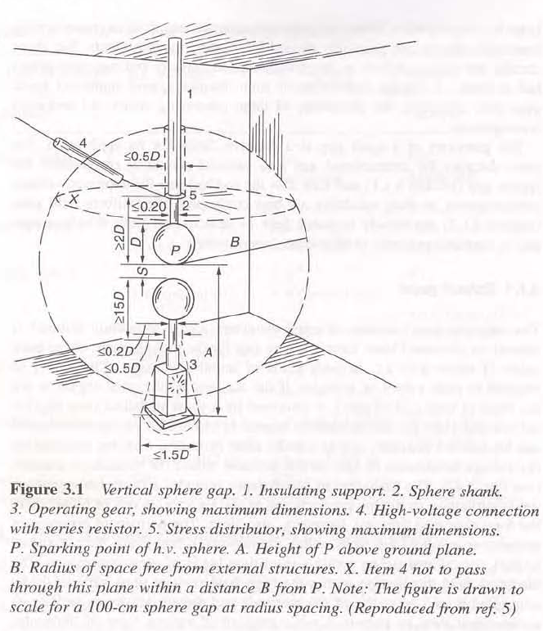
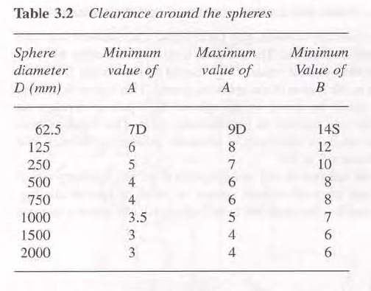
Fundamentals of High Voltage Techniques
Vertical sphere gap
MUST fulfill demands
of chapter 3.1.1

Slide 13
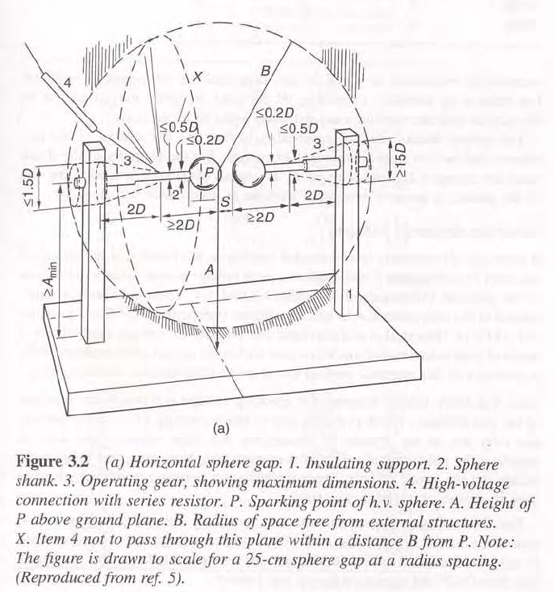
Fundamentals of High Voltage Techniques

Slide 14
Fundamentals of High Voltage Techniques

Slide 15
Fundamentals of High Voltage Techniques
Relation between gap length s and breakdown
voltage U_{d}

Slide 16
Fundamentals of High Voltage Techniques

Slide 17
Fundamentals of High Voltage Techniques

Slide 18
Fundamentals of High Voltage Techniques
Generation and measurement of high DC voltages

Slide 19
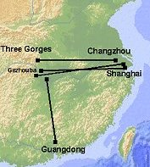
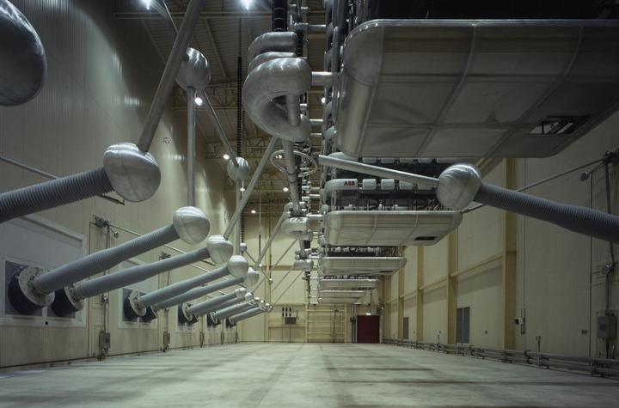
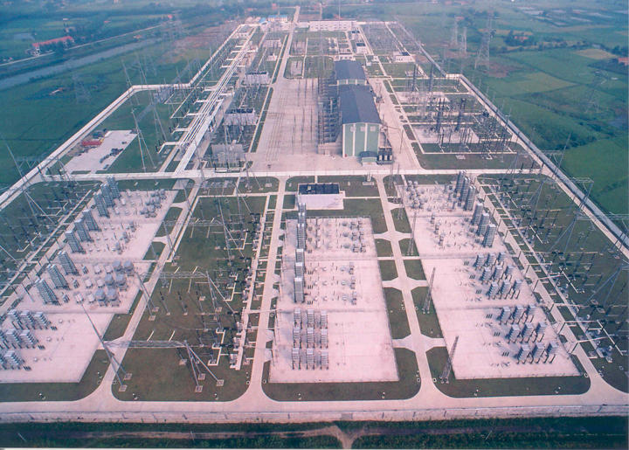
Fundamentals of High Voltage Techniques
HVDC Three Gorges

Slide 20
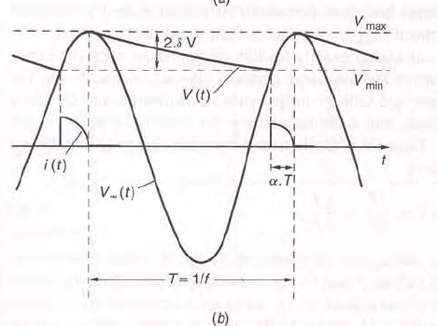
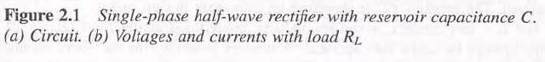
Fundamentals of High Voltage Techniques

Slide 21
Fundamentals of High Voltage Techniques
Single stage
Greinacher

Slide 22
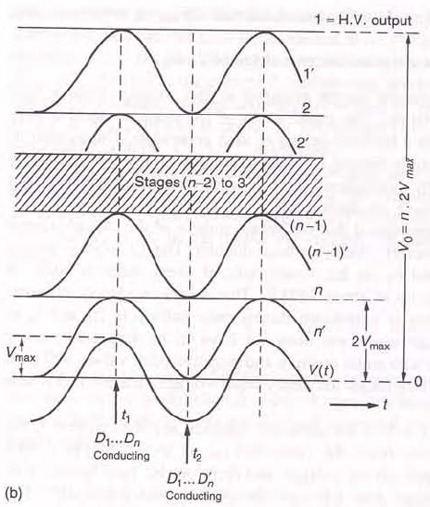
Fundamentals of High Voltage Techniques
No load of Cockcroft-Walton multi-stage

Slide 23
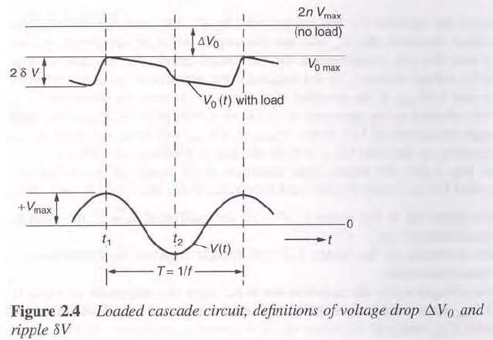
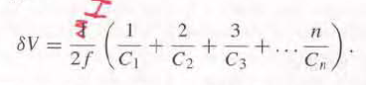
Fundamentals of High Voltage Techniques
Loading of Cockcroft-Walton stage
RIPPLE
Lowest capacitances makes
most ripple. Increasing not
possible, because of uneven
potential sharing during
breakdown of DUT
Equal capacitances makes

Slide 24
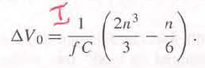
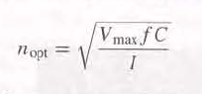
Fundamentals of High Voltage Techniques
VOLTAGE DROP when loading
With doubled C’_{n}
Optimum number of stages

Slide 25
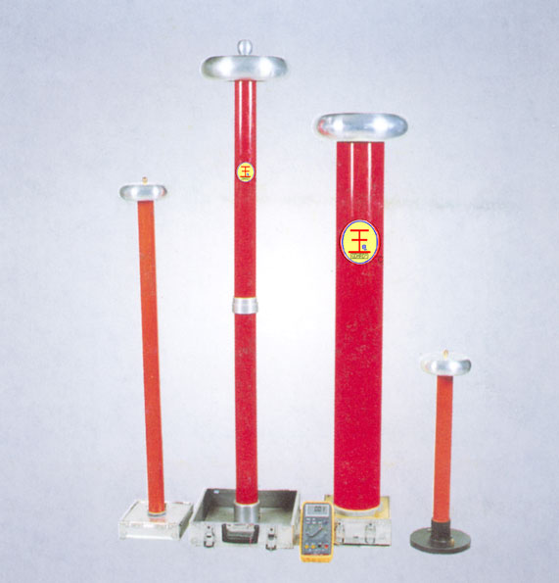
Fundamentals of High Voltage Techniques

Slide 26
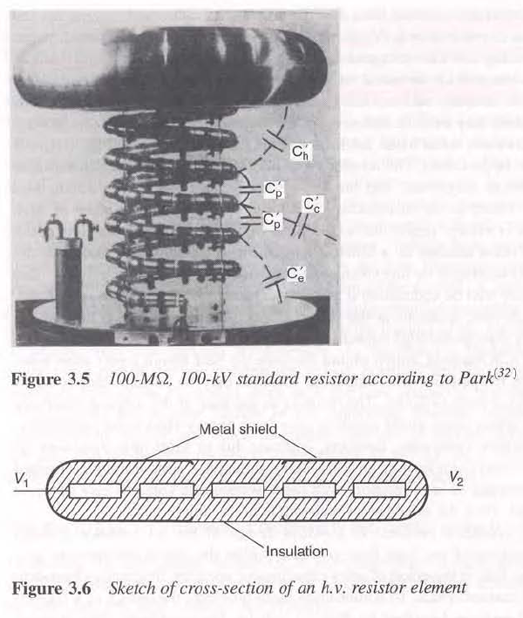
Fundamentals of High Voltage Techniques
Very accurate control
of electric potential
distribution achieved
by use of HV resistor
elements in a helix-wound
shape.
Corona should be avoided
because of leakage current

